Slide 1
Influence of Sleep Cycle on Bipolar Episodes
Complex System Simulation
University of Amsterdam
28 June 2019
By : Guy Frankel, Arja Rydin, Nathalie van Sterkenburg, Jason Tsiaxiras
Notes:
We are
Circ. act. Rhythm changes w/ BD
Emergent behaviour changes in neurotr. levels

Slide 2

Introduction
Toward a complex system understanding of bipolar disorder: A chaotic model of abnormal circadian activity rhythms in euthymic bipolar disorder, Hadaeghi et al. (2016) ¹
Circadian activity rhythm - sleep-wake cycle
Notes:
Hadeaghi
Math. mod. Sl-wa cycle (circ act rhy) people

Slide 3
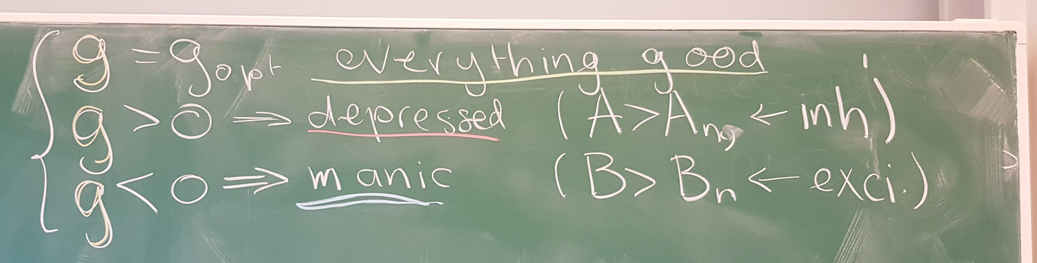
Bipolar Disorder
Patients suffer from extreme shifts in mood²
Manic periods and depressed periods²
Cause²
combination of genetics and environment
Treatment²
medication (often Lithium)
Psychotherapy
Observation: large changes in Circadian Activity Rhythm³
Research field with potential
Notes:
Ppl w/ BD periods
No cure, medication and therapy
fluctuations

Slide 4
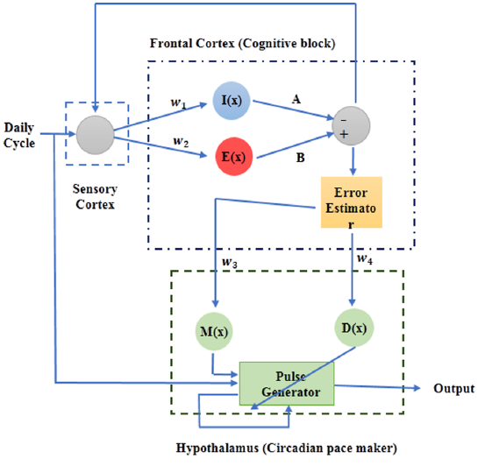
Model
x(n+1)
Neuronal activity
e(n)
Input signal
Notes:
Top box - x neuronal activity
Error estimator deviation
Input bottom box regulates c.a.r. Generated by a pulse generator
Pulse generated by rulkov map

Slide 5
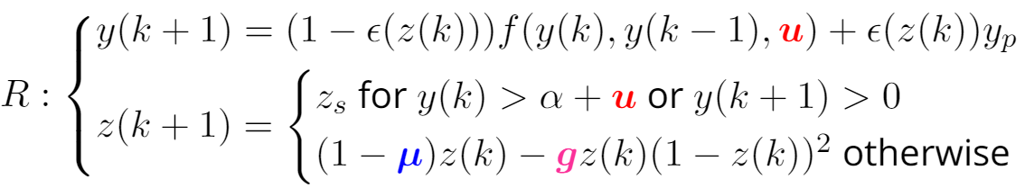
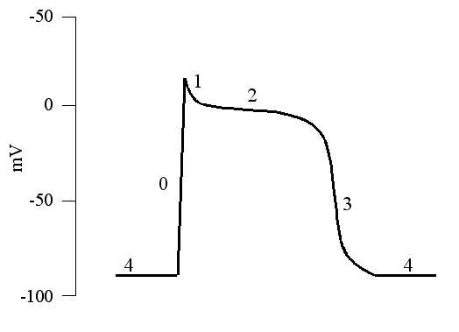
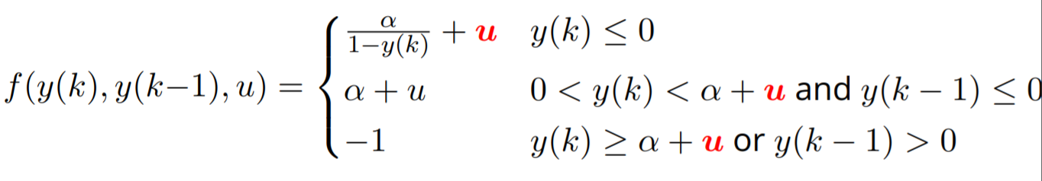
Rulkov Map^{4,5}
Notes:
Biological neuron compuationally efficient
U - I_ext
Mu - large wide AP
G - constant but for us function of Inh and Exc

Slide 6
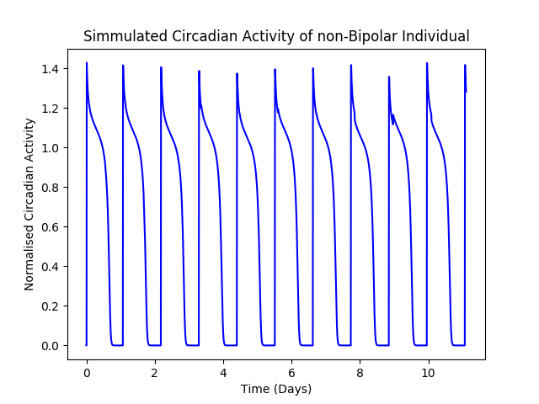
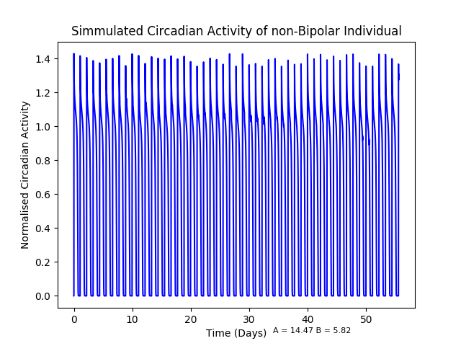
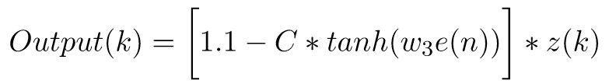


Normal Sleep Cycle

Slide 7
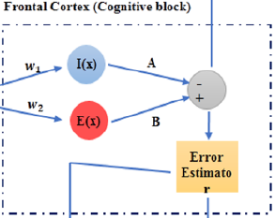

Input Signal
w₁=0.2223, w₂=1.487
Notes:
Strength parameters
Error determines day to day change

Slide 8
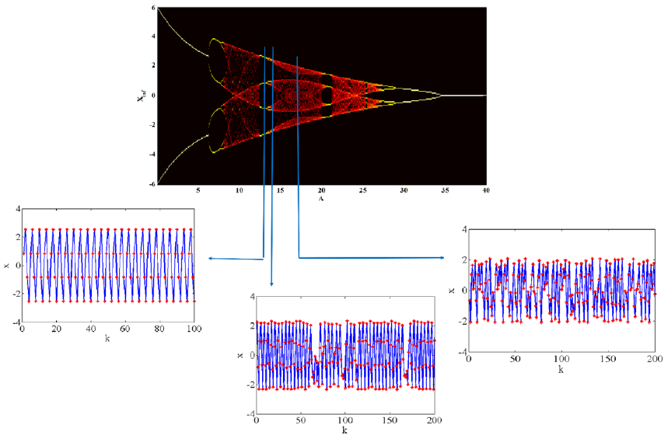
Bifurcation Map
B=5.82
A=13.6
A=16.5
A=14.8
Notes:
Time series for a values
Stable, chaotic, intermittent
Edge of chaos

Slide 9
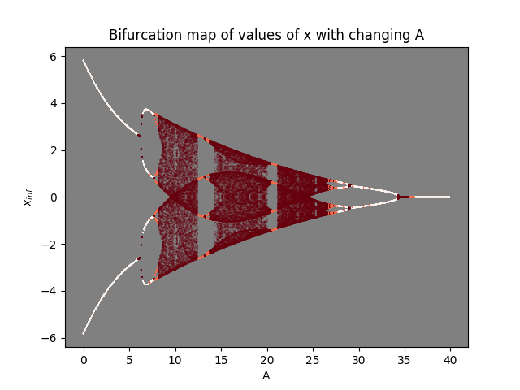
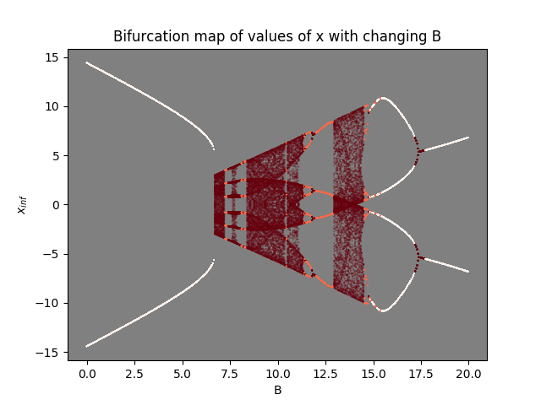
Bifurcation Map
B=5.82
A=14.31
Notes:
Intermittency vs period doubling

Slide 10
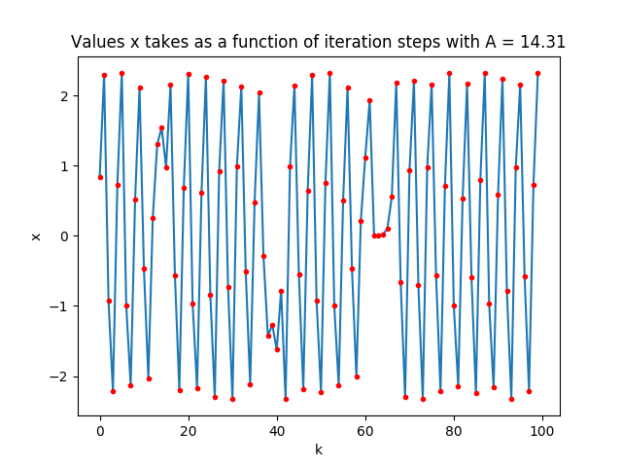
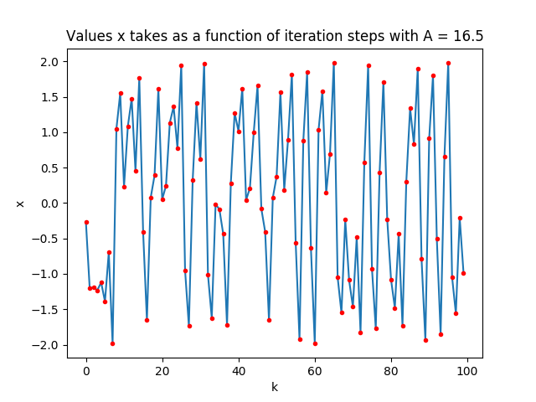
x(k)
Normal State Bipolar State
B=5.82
Notes:
Using the bifurcation maps to identify suitable parameters

Slide 11
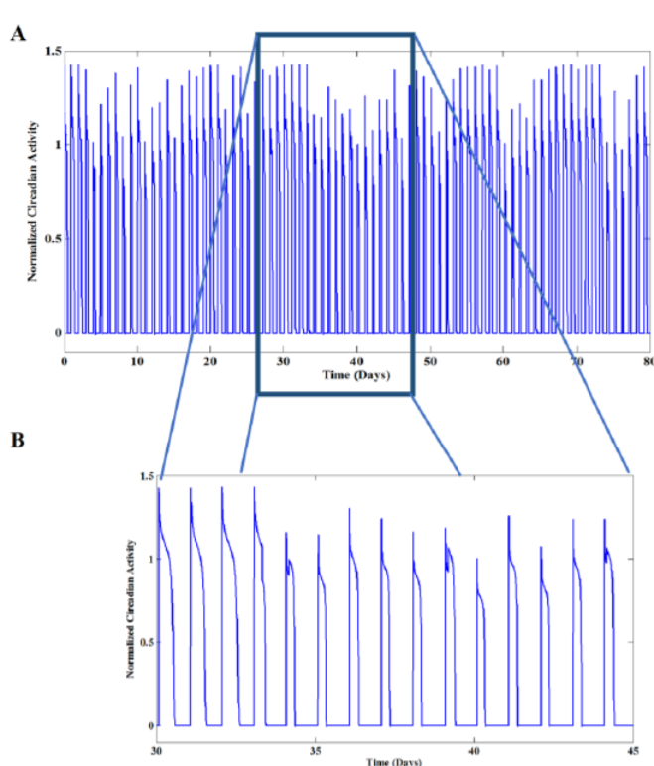
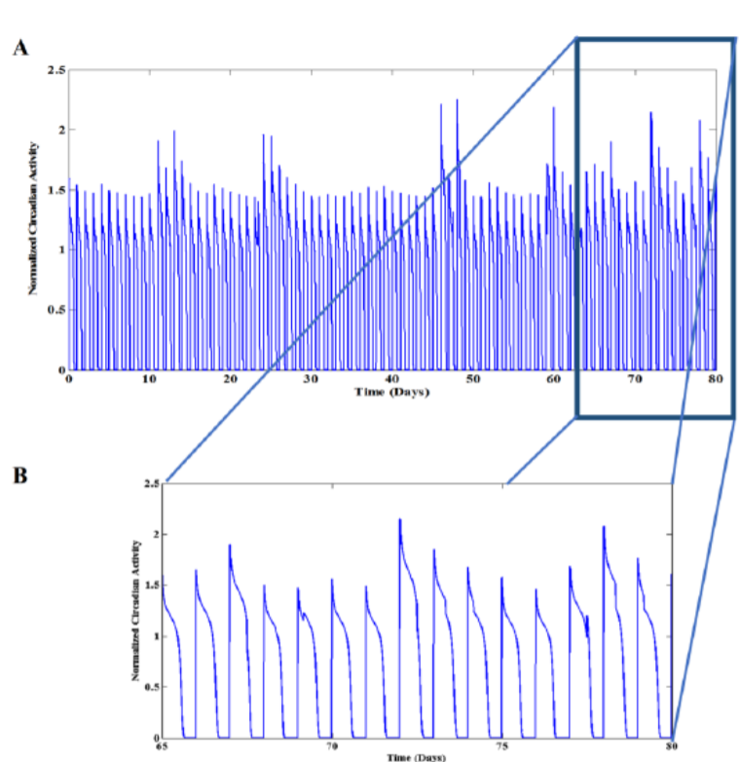
Circadian Activity - Depressed and Manic states

Slide 12
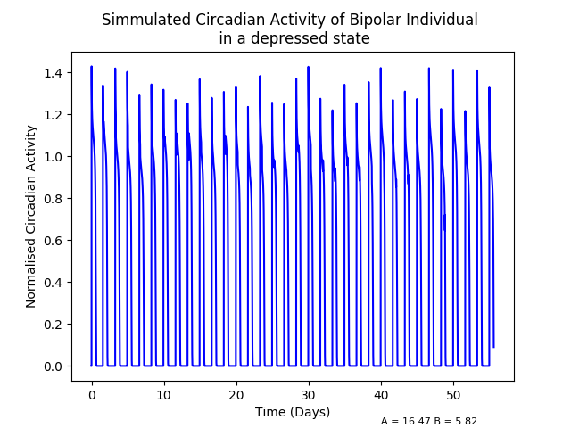
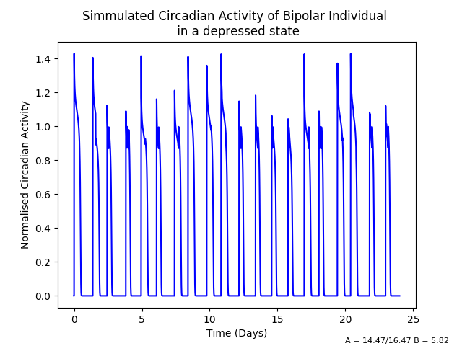
Rythmic Circadian Activity - Depressed State

Slide 13
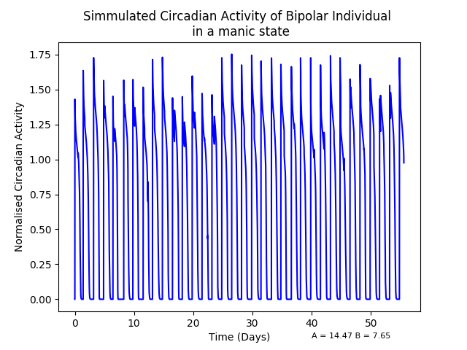
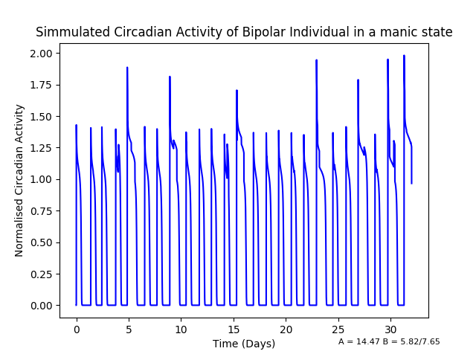
Rythmic Circadian Activity - Manic State

Slide 14
Significance and Further Research
Real data
Early warning signals
Managing bipolar disorder

Slide 15
References
Hadaeghi, F., Hashemi Golpayegani, M. R., Jafari, S., & Murray, G. (2016). Toward a complex system understanding of bipolar disorder: A chaotic model of abnormal circadian activity rhythms in euthymic bipolar disorder. Australian & New Zealand Journal of Psychiatry, 50(8), 783-792.
Belmaker, R. H. (2004). Bipolar disorder. New England Journal of Medicine, 351(5), 476-486.
McKenna, B. S., Drummond, S. P., & Eyler, L. T. (2014). Associations between circadian activity rhythms and functional brain abnormalities among euthymic bipolar patients: a preliminary study. Journal of affective disorders, 164, 101-106.
Rulkov, N. F. (2002). Modeling of spiking-bursting neural behavior using two-dimensional map. Physical Review E, 65(4), 041922.
Rulkov, N. F. (2007). A map-based model of the cardiac action potential. arXiv preprint arXiv:0708.1173.

